Slide 1
__L1n__w@tch
Ten Quiz

Slide 2
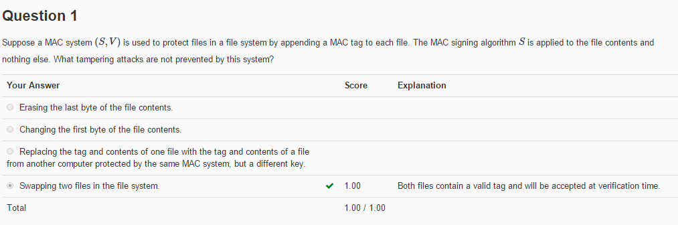
Question 1
解析：
因为只对文件内容进行MAC，并没有对文件的路径啥的进行MAC，所以交换两个合法Tag的文件是可能的。

Slide 3
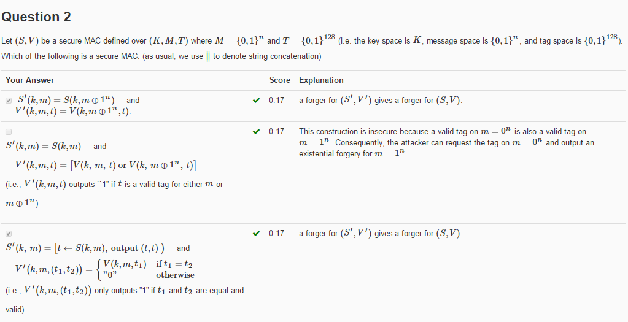
Question 2
解析：
判断是否可以伪造标签即可。

Slide 4
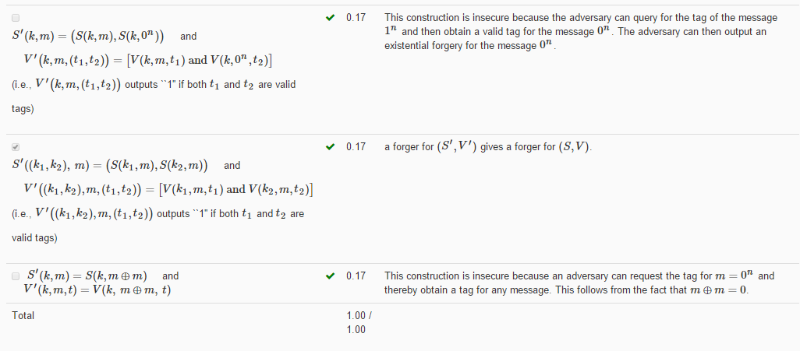
Question 2

Slide 5
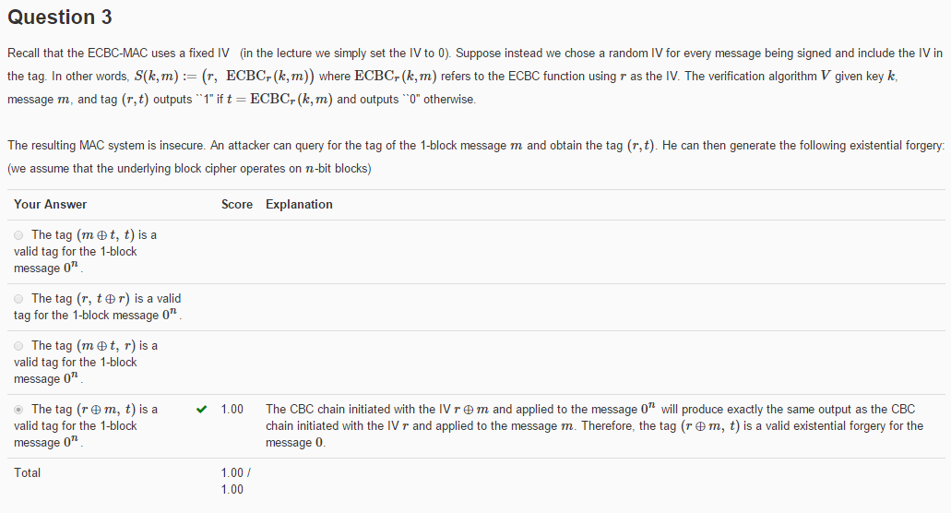
__L1n__w@tch
Question 3
解析：
证明其可以伪造标签即可。

Slide 6
Problem_set_2-3思路
__L1n__w@tch
Question 4
Suppose Alice is broadcasting packets to 6 recipients B1,…,B6. Privacy is not important but integrity is. In other words, each of B1,…,B6 should be assured that the packets he is receiving were sent by Alice.
Alice decides to use a MAC. Suppose Alice and B1,…,B6 all share a secret key k. Alice computes a tag for every packet she sends using key k. Each user Bi verifies the tag when receiving the packet and drops the packet if the tag is invalid. Alice notices that this scheme is insecure because user B1 can use the key k to send packets with a valid tag to users B2,…,B6 and they will all be fooled into thinking that these packets are from Alice.
Instead, Alice sets up a set of 4 secret keys S={k1,…,k4}. She gives each user Bi some subset Si⊆S of the keys. When Alice transmits a packet she appends 4 tags to it by computing the tag with each of her 4 keys. When user Bi receives a packet he accepts it as valid only if all tags corresponding to his keys in Si are valid. For example, if user B1 is given keys {k1,k2} he will accept an incoming packet only if the first and second tags are valid. Note that B1 cannot validate the 3rd and 4th tags because he does not have k3 or k4.
How should Alice assign keys to the 6 users so that no single user can forge packets on behalf of Alice and fool some other user?

Slide 7
Question 4
Your Answer | Explanation
S1={k1,k2}, S2={k2,k3}, S3={k3,k4}, S4={k1,k3}, S5={k1,k2}, S6={k1,k4} | S1可以伪造消息给S5
S1={k1,k2}, S2={k1,k3,k4}, S3={k1,k4}, S4={k2,k3}, S5={k2,k3,k4}, S6={k3,k4} | S2可以伪造消息给S6
S1={k1,k2}, S2={k1,k3}, S3={k1,k4}, S4={k2,k3}, S5={k2,k4}, S6={k3,k4} | Every user can only generate tags with the two keys he has. Since no set Si is contained in another set Sj, no user i can fool a user j into accepting a message sent by i.
S1={k1,k2}, S2={k1,k3}, S3={k1,k4}, S4={k2,k3}, S5={k2,k4}, S6={k4} | S3可以伪造消息给S6
解析：
要求是每个s所拥有的密钥所对应的MAC都是对的。

Slide 8
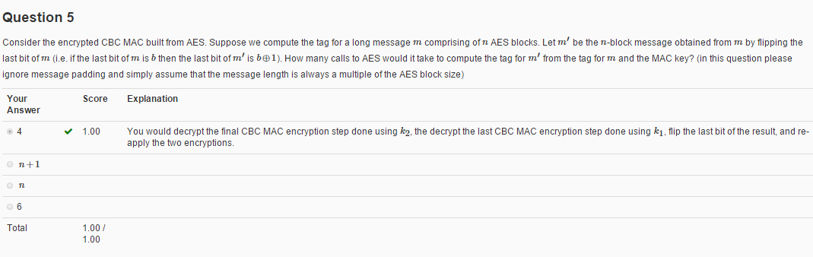
__L1n__w@tch
Question 5
解析：
只有最后一块改变了，所以2次解密后进行异或，再2次加密即可

Slide 9
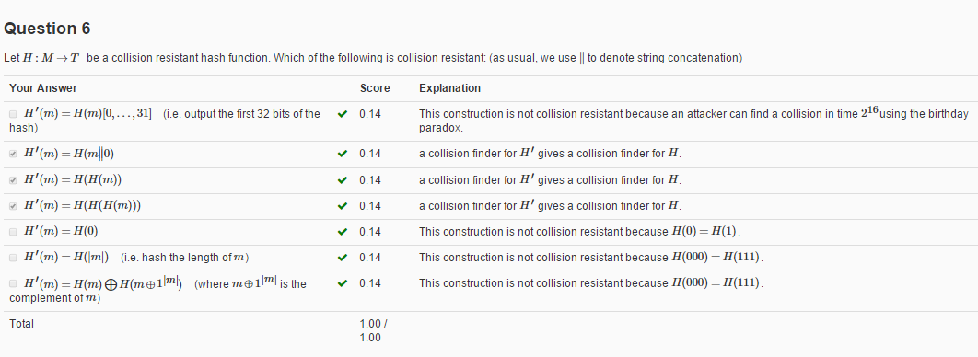
__L1n__w@tch
Question 6
解析：
看能否找到碰撞对。

Slide 10
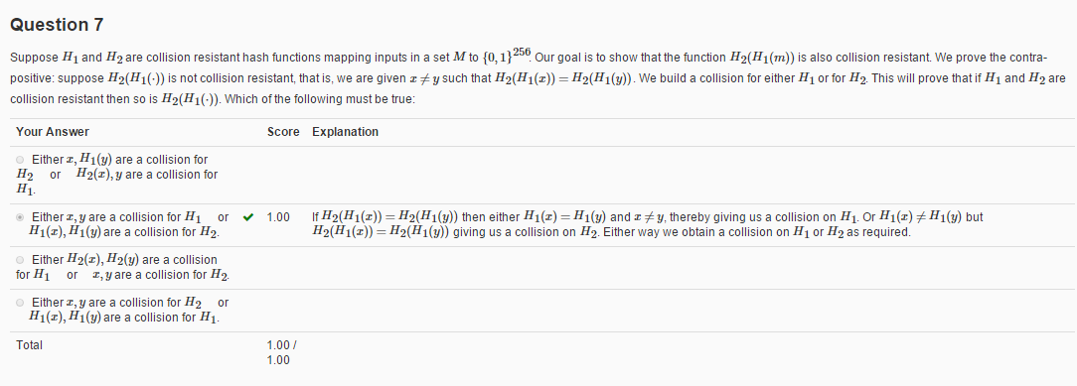
__L1n__w@tch
Question 7
解析：
看能否找到碰撞对。

Slide 11
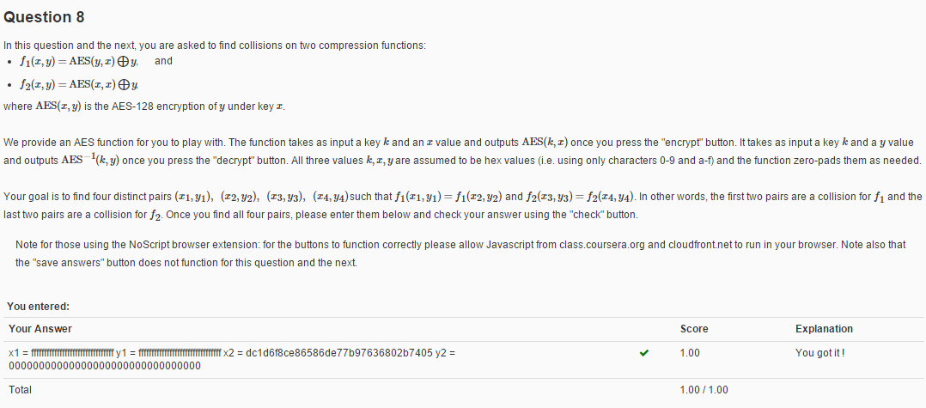
__L1n__w@tch
Question 8
Question 8:
解析：
F1:
Y1 = Fn,x1 = Fn
AES(y1, x1 ) = y2 = bcbf217cb280cf30b2517052193ab979
求x2即可

Slide 12
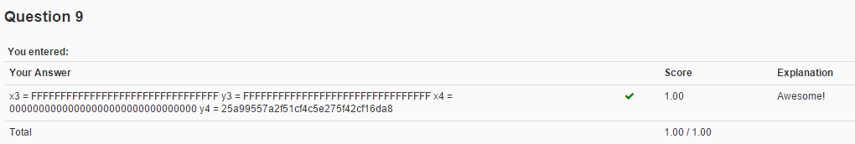
__L1n__w@tch
Question 9
解析：
F2:
这个好像简单好多
令x1 = x2 = y1 = Fn，异或一下 就可以求出y2了
X1 = FFFFFFFFFFFFFFFFFFFFFFFFFFFFFFFF
AES(x1, x1) = bcbf217cb280cf30b2517052193ab979
X2 = 00000000000000000000000000000000
AES(x2, x2) = 66e94bd4ef8a2c3b884cfa59ca342b2e
Y1 = FFFFFFFFFFFFFFFFFFFFFFFFFFFFFFFF
Y2 = 三者异或 = bcbf217cb280cf30b2517052193ab979 xor 66e94bd4ef8a2c3b884cfa59ca342b2e xor FFFFFFFFFFFFFFFFFFFFFFFFFFFFFFFF
= 25a99557a2f51cf4c5e275f42cf16da8

Slide 13
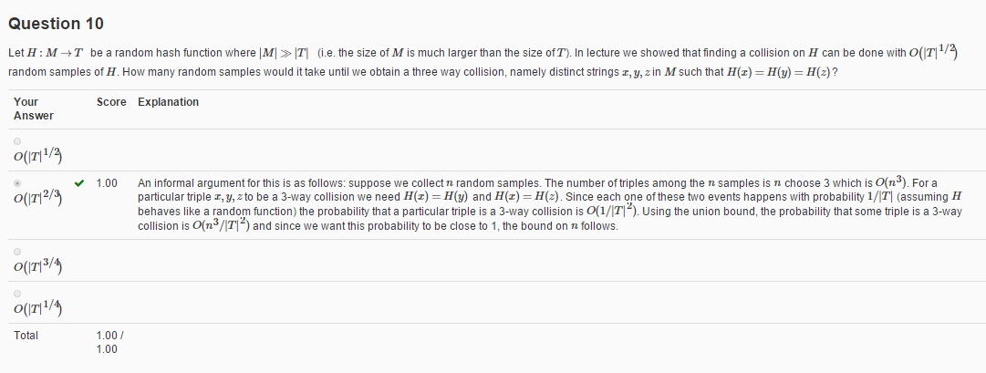
Question 10
解析：
不明觉厉。

Slide 14
__L1n__w@tch
In the end
T
H
A
N
K
Y
0
U

